Slide 1
Adversarial example
Speaker:Jie Wang

Slide 2
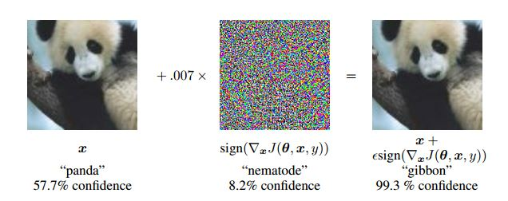
Adversarial Example...

Slide 3
Common Terms
Adversarial attacks Methods to generate adversarial examples.
Adversarial defenses Methods to defend against adversarial examples.
Whitebox attack
Blackbox attack
Targeted attack
Non-targeted attack
Adversarial training

Slide 4
Transferability
Yet, we found that adversarial examples are relatively robust, and are shared by neural networks with varied number of layers, activations or trained on different subsets of the training data. That is, if we use one neural net to generate a set of adversarial examples, we find that these examples are still statistically hard for another neural network even when it was trained with different hyperparameters or, most surprisingly, when it was trained on a different set of examples.

Slide 5
Intriguing properties of neural networks
(Szegedy et.al)
But as the resulting computation is automatically discovered by backpropagation via supervised learning, it can be difficult to interpret and can have counter-intuitive properties.
The first property is concerned with the semantic meaning of individual units…
The second property is concerned with the stability of neural networks with respect to small perturbations to their inputs.

Slide 6
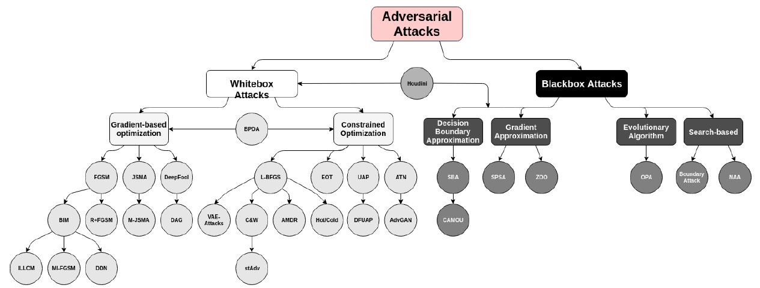
Adversarial Attacks

Slide 7
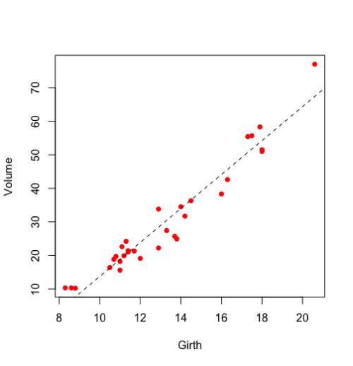
Multiple linear regression

Slide 8

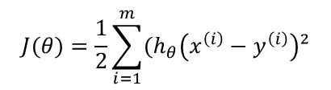
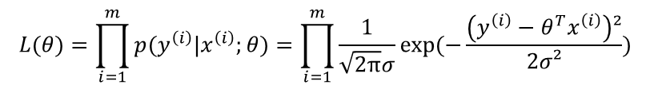

Maximum Likelihood Estimate
$$f(x)=\frac{1}{\sqrt{2π}σ}exp⁡(−\frac{\left(x−μ\right)²}{2σ²})$$
$$p(y^{\left(i\right)}|x^{\left(i\right)};θ)=\frac{1}{\sqrt{2π}σ}exp⁡(−\frac{\left(y^{\left(i\right)}−θ^{T}x^{\left(i\right)}\right)²}{2σ²})$$
$$L(θ)=\prod_{i=1}^{m}{p(y^{\left(i\right)}|x^{\left(i\right)};θ})=\prod_{i=1}^{m}{\frac{1}{\sqrt{2π}σ}exp⁡(−\frac{\left(y^{\left(i\right)}−θ^{T}x^{\left(i\right)}\right)²}{2σ²})}$$
$$l\left(θ\right)=logL(θ)=log\prod_{i=1}^{m}{\frac{1}{\sqrt{2π}σ}\exp\left(−\frac{{\left(y^{\left(i\right)}−θ^{T}x^{\left(i\right)}\right)}^{2}}{2σ^{2}}\right)=\sum_{i=1}^{m}{log\frac{1}{\sqrt{2π}σ}exp⁡(−\frac{\left(y^{\left(i\right)}−θ^{T}x^{\left(i\right)}\right)²}{2σ²}) }}$$
$$J(θ)=\frac{1}{2}\sum_{i=1}^{m}{(h_{θ}\left(x^{\left(i\right)}−y^{\left(i\right)}\right)²}$$

Slide 9
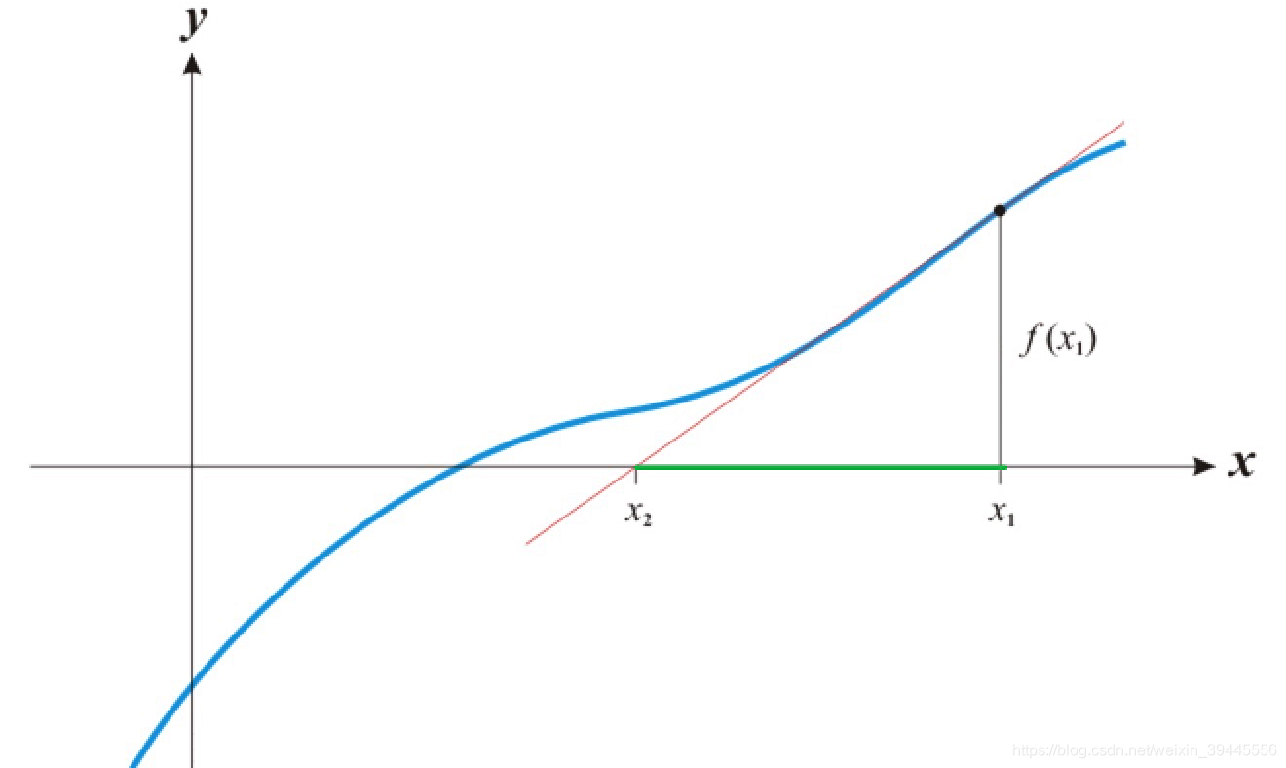





Quasi-Newton method

Slide 10


BFGS
L-BFGS approximate BFGS

Slide 11

L-BFGS
These perturbations are found by optimizing the input to maximize the prediction error. We term the so perturbed examples “adversarial examples”.

Slide 12

FGSM
Early attempts at explaining this phenomenon (adversarial examples) focused on nonlinearity and overfitting. We argue instead that the primary cause of neural networks’ vulnerability to adversarial perturbation is their linear nature. Moreover,this view yields a simple and fast method of generating adversarial examples.

Slide 13
Questions ?

Slide 14
Thank You!

